Slide 1

A Primer on Carbon Dioxide Chemistry
09/30/2015
Presented By Michael C. Young

Slide 2
Carbon Dioxide
CAS #: 124-38-9
MW: 44.01
Appearance: Colorless Gas
Density @ 273ºK: 1.977 mg/mL
IR Stretching Frequencies: 2349, 1286-1388, 667cm⁻¹
Sigma-Aldrich Price: $276/227g…
Generally considered chemically inert…
http://www.sigmaaldrich.com/catalog/product/aldrich/295108?lang=en&region=US, Accessed 09/28/2015.
North, M. Carbon Dioxide Utilization: Closing the Carbon Cycle, 2014, Ch. 1, pgs 3-17.

Slide 3
Discovery
Carbon dioxide was the first discrete gas to be isolated and described;
The first observation of carbon dioxide was made by a Flemish chemist, Jan Baptist van Helmont, around the year 1640;
Helmont burned charcoal, and postulated that an invisible substance must account for the loss of mass;
Helmont also correctly suggested that this gas was the same as that given off by fermentation;
Joseph Black and Joseph Priestly also studied the much denser Fixed Air, and discovered many ways to produce it from lime and chalk;
Surprisingly, liquid CO₂ was first described in 1823, while dry ice was not reported until 1835 by Adrien-Jean-Pierre Thilorier.
https://en.wikipedia.org/wiki/Carbon_dioxide, Accessed 9/28/2015
Thilorier, A. Comptes Rendus Hebdomadaires des Séances de l'Académie des Sciences, 1835, 1, 194.

Slide 4
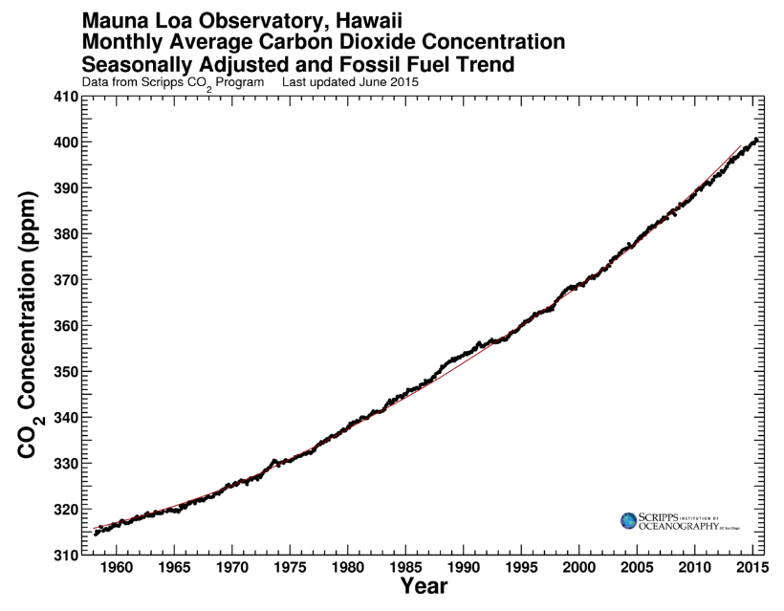
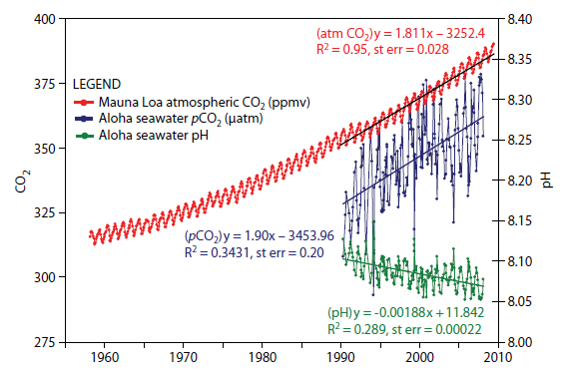

Current Focus on Carbon Dioxide
Environmental Concerns
Cheap/Renewable Feedstock
Atmospheric CO₂
Oceanic CO₂
http://scrippsco2.ucsd.edu/graphics_gallery/mauna_loa_record/mauna_loa_seas_adj_fossil_fuel_trend, Accessed 09/28/2015
http://uclafacultyassociation.blogspot.com/2013/06/cheap-cheap.html, Accessed 09/28/2015

Slide 5
Driving Force for Chemistry
Although carbon dioxide is highly stable (H_{f} = -394 kJ/mol), there are many ways to generate stable products;
High electrophilicity of central carbon makes addition of nucleophiles accessible;
High energy starting materials are can lead to favorable exothermic reactions with negative ∆G‡ and ∆H, overriding the intrinsic stability of CO₂;
Weaker reactants lead to equilibrium mixtures of product and starting materials, and can be driven forward according to Le Châtelier’s Principle.
Figures based on 2012
North, M. Carbon Dioxide Utilization: Closing the Carbon Cycle, 2014, Ch. 1, pgs 3-17.

Slide 6
CO₂ As Solvent (Liquid Phase)
Liquid CO₂ has similar properties to hydrocarbon solvents, and prior to the advent of supercritical CO₂ was commonly used for extracting components from a variety of botanical sources.
Marriott, R.; Jessop, P.; Barnes, M. Carbon Dioxide Utilization: Closing the Carbon Cycle, 2014, Ch. 6, pgs 73-96.

Slide 7
CO₂ As Solvent (Super Critical Phase)
scCO₂ has become commonly used solvent in part because of regulations limiting solvent use in isolation of ingredients for food, beverage, and personal care products;
A major benefit of scCO₂ is that its properties can be tuned based on temperature and pressure, being similar to n-pentane at low density and closer to pyridine at high density;
scCO₂ is a useful solvent for reactions of gases (H₂);
scCO₂ can be effectively used for heterogeneous .
catalysis, as it leads to a single gas/liquid phase;
Although metal catalysts are frequently insoluble, .
fluoronated ligands can sometime overcome this .
allowing homogeneous catalysis in scCO₂.
Marriott, R.; Jessop, P.; Barnes, M. Carbon Dioxide Utilization: Closing the Carbon Cycle, 2014, Ch. 6, pgs 73-96.

Slide 8
Enhancing Solvent Properties (CXL)
Discovered in 1911 by a German graduate student, many solvents will expand upon treatment with increasing CO₂ pressure, leading to easily changed properties;
Fluxuation of pressure can be .
used to modulated solubility, .
causing products, catalysts, or .
co-solvents to easily separate .
out of a reaction mixture.
Polar solvents such as DMSO .
and MeOH can become similar in .
polarity to Et₂O;
Primarily used in Enhanced Oil .
Recovery, where CO₂ dissolution .
leads to decreased oil viscosity.
Marriott, R.; Jessop, P.; Barnes, M. Carbon Dioxide Utilization: Closing the Carbon Cycle, 2014, Ch. 6, pgs 73-96.

Slide 9
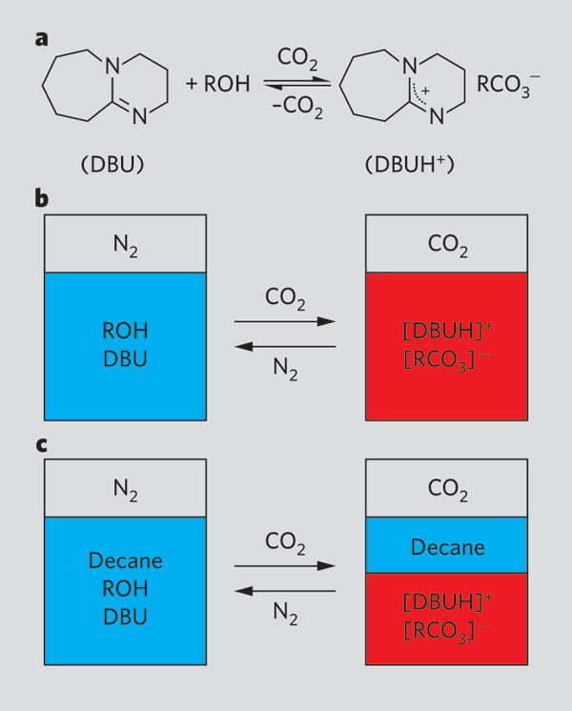
Switchable Solvents
Jessop, P. G.; Heldebrant, D. J.; Li, X.; Eckert, C. A.; Liotta, C. L. Nature, 2005, 436, 1102.
Marriott, R.; Jessop, P.; Barnes, M. Carbon Dioxide Utilization: Closing the Carbon Cycle, 2014, Ch. 6, pgs 73-96.

Slide 10
CO₂ Separation From Waste Streams
There are numerous amine-based systems for chemisorption of CO₂;
Typically aqueous solutions of the amines are used;
Simple amines are ineffective, only aminoalcohols seem to be effective.
Styring, P. Carbon Dioxide Utilization: Closing the Carbon Cycle, 2014, Ch. 2, pgs 19-32.

Slide 11
CO₂ Separation From Waste Streams
A major draw back is the number of decomposition pathways available, which leads to a significant need to replace the CO₂ chemisorption agent;
Even without radicals, simple thermal decomposition pathways are available during desorption.
Styring, P. Carbon Dioxide Utilization: Closing the Carbon Cycle, 2014, Ch. 2, pgs 19-32.

Slide 12
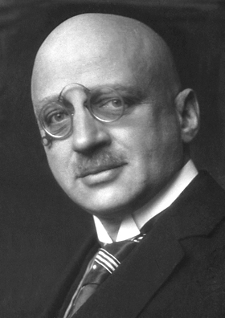
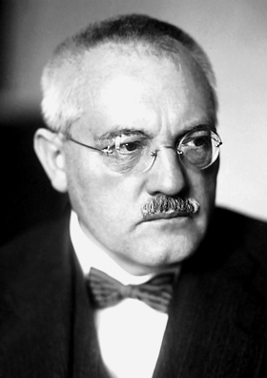
Turning CO₂ into Urea
The first step (the Haber-Bosch Process) produces gaseous ammonia from N₂ and H₂ after the introduction of high heat and pressure;
Using this liquified ammonia, two set of equilibria lead to the production of urea through the Bosch-Meiser Process:
Fritz Haber
Carl Bosch
Schaschke, C. Oxford Dictionary of Chemical Engineering, 2014, Oxford University Press, Oxford, UK.
Notes:
Haber first showed a small scale application of converting nitrogen into ammonia, and then Bosch, with BASF at the time, showed that it could be done at process scale. Bosch then went on to develop a process to convert ammonia and CO2 into urea, a process which is still used with only slight modifications 93 years later.
Talk about Nazi/chemical warfare vs anti-Nazi.

Slide 13
Adding CO₂ to Phenols
Initially observed by heating phenol, sodium, and CO₂ in a dry vessel;
Under anhydrous conditions and increased pressures, the reaction can proceed in high, reproducible yields: this is still the standard for synthesis of many salicylates in most countries;
Evidence supports that these reactions proceed via an η-1 coordination to CO₂, meaning both hydration state and cation are important: potassium and larger salts sometimes favor p-addition.
Lindsey, A. S.; Jeskey, H. Chem. Rev., 1957, 57, 583.
Notes:
The Kolbe-Schmitt reaction is the leading way in which phenolic carboxylic acids are synthesized. Polyhydroxybenzenes are understandably more reactive, and can often react under aqueous solution with lower CO2 pressure.

Slide 14
Known Metal-CO₂ Complexes
At least 13 different coordination modes are known for CO₂ with between one and four metals!
North, M. Carbon Dioxide Utilization: Closing the Carbon Cycle, 2014, Ch. 1, pgs 3-17.

Slide 15
Carboxylic Acids via Metal-Carbon Bonds
High energy intermediates lead to often fast/high yielding reactions without the need for high CO₂ pressure.
Nagaki, A.; Takahashi, Y.; Yoshida, J.-I. Chem. Eur. J., 2014, 20, 7931.
Wu, J.; Yang, X.; He, Z.; Mao, X.; Hatton, T. A.; Jamison, T. F. Angew. Chem., Int. Ed., 2014, 53, 8416.
De Boer, H. J. R.; Akkerman, O. S.; Bickelhaupt, F. J. Organomet. Chem., 1987, 321, 291.
Tajammal, S.; Tipping, A. E. J. Fluorine Chem., 1990, 47, 45.
Notes:
The Kolbe-Schmitt reaction is the leading way in which phenolic carboxylic acids are synthesized.

Slide 16
What About Soft M-C Bonds (Zn)?
Alkyl zinc reagents are usually too soft to directly react with CO₂;
There is a recent example of a three component coupling between an alkene, alkyl zinc, and CO₂;
Gaudemar, M. Bull. Soc. Chimi. France, 1962, 5, 974.
Ohira, Y.; Hayashi, M.; Mori, T.; Onodera, G.; Kimura, M. New. J. Chem., 2014, 38, 330.
Notes:
This allyl zinc reagent is the only one reported to directly add to CO2 directly.

Slide 17
Catalyzing Zn-C Bond Transfer to CO₂
Michel Arresta showed that CO₂ could form η-2 complex .
with electron rich Ni(0) sources such as [Ni(PCy₃)₂];
Vy Dong’s group chose to look at using this activated .
complex to access catalytic activation of CO₂;
Aresta, M.; Nobile, C. F.; Albano, V. G.; Forni, E.; Manassero, M. J. Am. Chem. Soc., 1975, 15, 636.
Yeung, C. S.; Dong, V. M. J. Am. Chem. Soc., 2008, 130, 7826.

Slide 18
Catalyzing Zn-C Bond Transfer to CO₂
Both Ni and Pd were effective catalysts for activating CO₂ for nucleophilic attack by organozinc reagents.
Yeung, C. S.; Dong, V. M. J. Am. Chem. Soc., 2008, 130, 7826.
Notes:
Aromatic zinc compounds could be reacted using Pd catalyst, while Ni allowed aryl and alkyl zinc reagents to react.

Slide 19
Catalyzing Zn-C Bond Transfer to CO₂
Oshima reported contemporaneously the same reaction, except starting with a Ni(II) precatalyst;
Similar to Vy Dong’s protocol, electron rich ligands seem critical;
Unlike Vy Dong’s work, these reactions in general require a LiCl additive.
Ochiai, H.; Jang, M.; Hirano, K.; Yorimitsu, H.; Oshima, K. Org. Lett., 2008, 10, 2681.
Notes:
Similar…

Slide 20
Catalyzing Zn-C Bond Transfer to CO₂
Conditions require modification to port over to aryl zinc reagents;
Oshima proposed a similar cycle, with Ni(0) formed in situ to allow coordination to CO₂.
Ochiai, H.; Jang, M.; Hirano, K.; Yorimitsu, H.; Oshima, K. Org. Lett., 2008, 10, 2681.
Notes:
But not as good.

Slide 21
Catalyzing Zn-C Bond Transfer to CO₂
Similar to their previous work, could Kimura’s
group replace an aldehyde with CO₂ during a multicomponent coupling?
Mori, Y.; Mori, T.; Onodera, G.; Kimura, M. Synthesis, 2014, 46, 2287.

Slide 22
Catalyzing Zn-C Bond Transfer to CO₂
Proposed Mechanism
Mori, Y.; Mori, T.; Onodera, G.; Kimura, M. Synthesis, 2014, 46, 2287.
Notes:
Aromatic zinc compounds could be reacted using Pd catalyst, while Ni allowed aryl and alkyl zinc reagents to react.

Slide 23
Other Ni Reactions
First example of a Ni-Carbon species reacting with CO₂ was reported in 1985;
Pincer complexes sometimes require quite high barriers.
Bennett, M. A.; Hambley, T. W.; Roberts, N. K.; Robertson, G. B. Organometallics, 1985, 4, 1992.
Schmeier, T. J.; Hazari, N.; Incarvito, C. D.; Raskatov, J. A. Chem. Commun., 2011, 47, 1824.

Slide 24
Other Ni-X Substrates
Schmeier, T. J.; Nova, A.; Hazari, N.; Maseras, F. Chem. Eur. J., 2012, 18, 6915.

Slide 25
Ni-Catalyzed Reactions with Ar-X and CO₂
Although a similar reaction was described for Pd in 2009, use of Ni allows for Ar-Cl to be used;
Mild conditions;
Homocoupling generally less than with Pd catalyst.
Fujihara, T.; Nogi, K.; Xu, T.; Terao, J.; Tsuji, Y. J. Am. Chem. Soc., 2012, 134, 9106.

Slide 26
Ni-Catalyzed Reactions with Ar-X and CO₂
Fujihara, T.; Nogi, K.; Xu, T.; Terao, J.; Tsuji, Y. J. Am. Chem. Soc., 2012, 134, 9106.

Slide 27
Ni-Catalyzed Reactions with Ar-X and CO₂
Fujihara, T.; Nogi, K.; Xu, T.; Terao, J.; Tsuji, Y. J. Am. Chem. Soc., 2012, 134, 9106.

Slide 28
More Ni-Catalyzed Reactions!
Screening suggests that highly electron rich ligands are needed!
León, T.; Correa, A.; Martin, R. J. Am. Chem. Soc., 2013, 135, 1221.

Slide 29
More Ni-Catalyzed Reactions!
Mechanistic studies suggest a Ni(I) intermediate is at play!
León, T.; Correa, A.; Martin, R. J. Am. Chem. Soc., 2013, 135, 1221.

Slide 30
Last Ni-Catalyzed Reaction!
Tsuji showed an interesting dicarboxylation coupled with dehydration to give anhydrides.
Proposed Mechanism
Fujihara, T.; Horimoto, Y.; Mizoe, T.; Sayyed, F. B.; Tani, Y.; Terao, J.; Sakaki, S.; Tsuji, Y. Org. Lett., 2014, 16, 4960.

Slide 31
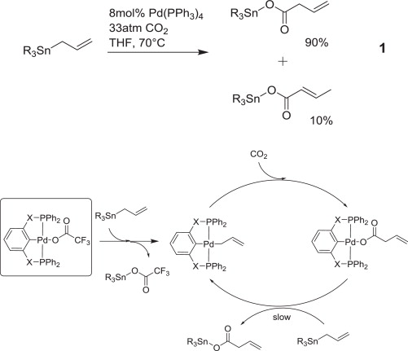
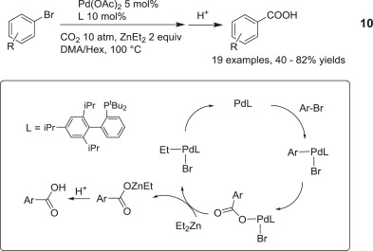
Pd-Catalyzed Reactions!
Pd less reactive than Ni in general for carboxylation reactions.
Yu, D.; Teong, S. P.; Zhang, Y. Coord. Chem. Rev., 2015, 293, 279.
Johansson, R.; Wendt, O. F. Dalton Trans., 2007, 488.
Carrea, A.; Martin, R. J. Am. Chem. Soc., 2009, 131, 15974.

Slide 32
Pd-Catalyzed Reactions!
Sasano, K.; takaya, J.; Iwasawa, N. J. Am. Chem. Soc., 2013, 135, 10954.

Slide 33
Pd-Catalyzed Reactions!
Proposed Mechanism
Sasano, K.; takaya, J.; Iwasawa, N. J. Am. Chem. Soc., 2013, 135, 10954.

Slide 34
What About Cu-C Bonds?
Copper complexes with a CO₂fixation…;
Ohishi, T.; Nishiura, M.; Hou, Z. Angew. Chem., Int. Ed., 2008, 47, 5792.

Slide 35
What About Cu-C Bonds?
Copper complexes with a CO₂fixation…;
3
4
Ohishi, T.; Nishiura, M.; Hou, Z. Angew. Chem., Int. Ed., 2008, 47, 5792.

Slide 36
What About Cu-C Bonds?
Also possible with allylic borate esters.
Duong, H. A.; Huleatt, P. B.; Tan, Q.-W.; Shuying, E. L. Org. Lett., 2013, 15, 4034.

Slide 37
What About Cu-C Bonds?
Duong, H. A.; Huleatt, P. B.; Tan, Q.-W.; Shuying, E. L. Org. Lett., 2013, 15, 4034.

Slide 38
What About Cu-C Bonds?
A related carboxylation of terminal alkynes suffered from low yields and scope using homogeneous conditions:
Yu, B.; Xie, J.-N.; Zhong, C.-L.; Li, W.; He, L.-N. ACS Catal., 2015, 5, 3940.

Slide 39
What About Cu-C Bonds?
Yu, B.; Xie, J.-N.; Zhong, C.-L.; Li, W.; He, L.-N. ACS Catal., 2015, 5, 3940.

Slide 40
What About Cu-C Bonds?
Although other metals had been shown to give a single regioisomer, using Cu it is possible to access regiodivergent products by modifying the conditions during allene silylcarboxylation
Tani, Y.; Fujihara, T.; Terao, J.; Tsuji, Y. J. Am. Chem. Soc., 2014, 136, 17706.

Slide 41
What About Cu-C Bonds?
Tani, Y.; Fujihara, T.; Terao, J.; Tsuji, Y. J. Am. Chem. Soc., 2014, 136, 17706.

Slide 42
What About Cu-C Bonds?
Further functionalization was possible:
Tani, Y.; Fujihara, T.; Terao, J.; Tsuji, Y. J. Am. Chem. Soc., 2014, 136, 17706.

Slide 43
What About Cu-C Bonds?
Apparently regiodivergent functionalization with CO₂ was all the rage!
Moragas, T.; Cornella, J.; Martin, R. J. Am. Chem. Soc., 2014, 136, 17702.

Slide 44
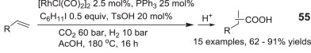
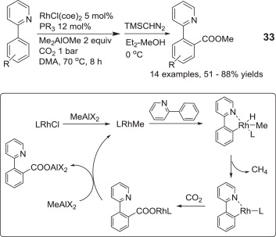
Rh-Catalyzed Reactions!
Rhodium can undergo directed C-H carboxylation, as well as many of the transmetallation-carboxylation reactions previously discussed.
Yu, D.; Teong, S. P.; Zhang, Y. Coord. Chem. Rev., 2015, 293, 279.
Mizuno, H.; Takaya, J.; Iwasawa, N. J. Am. Chem. Soc., 2011, 133, 1251.
Ostapowicz, T. G.; Schmitz, M.; Krystof, M.; Klankermayer, J.; Leitner, W. Angew. Chem., Int. Ed., 2013, 52, 12119.

Slide 45
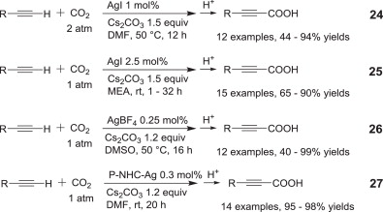
Ag and Au Catalyzed Reactions
Both silver and gold can catalyze carboxylation of appreciably acidic protons.
Yu, D.; Teong, S. P.; Zhang, Y. Coord. Chem. Rev., 2015, 293, 279.
Boogaerts, I. I. F.; Nolan, S. P. J. Am. Chem. Soc., 2010, 132, 8858.

Slide 46
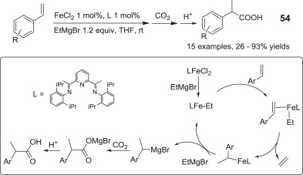
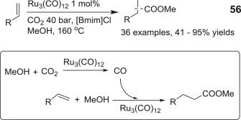
Iron and Ruthenium Reactions
Yu, D.; Teong, S. P.; Zhang, Y. Coord. Chem. Rev., 2015, 293, 279.
Greenhalgh, M. D.; Thomas, S. P. J. Am. Chem. Soc., 2012, 134, 11900.
Hoberg, H.; Jenni, K.; Krüger, C.; Raabe, E. Angew. Chem., Int. Ed., 1986, 25, 810.
Wu, L.; Liu, Q.; Fleischer, I.; Jackstell, R>; Beller, M. Nat. Commun., 2014, 5, 3091

Slide 47
Reactions with Strained Organics
Traditionally epoxides were reacted with CO₂ under high heat and pressure to generate cyclic carbonates, with early catalysts to alleviate this containing hydroxide, which led to numerous side reactions;
Use of strongly Lewis acidic metal catalysts combined with halides allows significant decrease in temperature and pressure (From 40-80 atm down to between 10-15 atm);
Current industrial standard is to use phosphonium salts, although these typically still require relatively high temperatures and pressure.
Heyn, R. H. Carbon Dioxide Utilization: Closing the Carbon Cycle, 2014, Ch. 7, pgs 97-13.
North, M.; Pasquale, R.; Young, C. Green Chem., 2010, 12, 1514.
Li, F.; Xiao, L.; Xia, C.; Hu, B. Tetrahedron Lett., 2004, 45, 8307.

Slide 48
Reactions with Strained Organics
To achieve activation at ambient conditions, it is necessary to activate both the epoxide and push the equilibrium towards carbonate which can be done by stabilizing the intermediate anion.
Not as successful… Requires 40 atm CO₂ pressure!
North, M.; Pasquale, R.; Young, C. Green Chem., 2010, 12, 1514.
Meléndez, J.; North, M.; Pasquale, R. Eur. J. Inorg. Chem., 2007, 3323.
Man, M. L.; Lam, K. C.; Sit, W. N.; Ng, S. M.; Zhou, Z.; Lin, Z.; Lau, C. P. Chem. Eur. J., 2006, 12, 1004.

Slide 49
Other Carbonate Reactions
Using a variety of catalysts, the following equilibrium can become synthetically practical;
Dessicants are typically required, with acetonitrile being used as a water trap;
Combining either method to make cyclic carbonates can lead to polycarbonates without the use of phosgene: as methyl isocyanate and ultimately phosgene become more expensive to make, this may provide a viable alternative.
North, M. Carbon Dioxide Utilization: Closing the Carbon Cycle, 2014, Ch. 1, pgs 3-17.
Heyn, R. H. Carbon Dioxide Utilization: Closing the Carbon Cycle, 2014, Ch. 7, pgs 97-13.

Slide 50
Polycarbonates from CO₂ and Epoxides
Both polycarbonates and polyether carbonates can be made, but require different catalysts;
Polycarbonate Catalyst
Polyether carbonate Catalyst
Langanke, J.; Wolf, A.; Peters, M. Carbon Dioxide Utilization: Closing the Carbon Cycle, 2014, Ch. 5, pgs 59-71.

Slide 51

Thank you for your attention!
http://lolworthy.com/funny/mars-crying-comic, Accessed 09/30/2015.

Slide 52
Question 1
There are a number of pathways that lead to monoethanolamine decomposition. We previously discussed how this can be achieved through radical pathways, but under the aqueous conditions used (in the presence of carbamic acids), there is another process that can occur. Unlike radical decomposition pathways that give rise to small molecules which are readily volatilized, thermal degradation leads to oligomers/polymers such as:
Propose a mechanism for the formation of these polyamine polymers:
Styring, P. Carbon Dioxide Utilization: Closing the Carbon Cycle, 2014, Ch. 2, pgs 19-32.

Slide 53
Question 2
Dong and Oshima proposed similar mechanisms for their Ni catalyzed addition of alkyl zinc reagents to carbon dioxide. The major difference was that Dong started with a Ni(0) source, while Oshima began with a Ni(II) precatalyst. Draw the complete catalytic circle for Oshima’s chemistry.
Ochiai, H.; Jang, M.; Hirano, K.; Yorimitsu, H.; Oshima, K. Org. Lett., 2008, 10, 2681.

Slide 54
Question 3
Acetonitrile is used as a water trap in the preparation of cyclic carbonates, but this can often lead to problems at the process scale because of significant production of by-products. Fill in the following table of simple by-products that can impede the reaction:
Heyn, R. H. Carbon Dioxide Utilization: Closing the Carbon Cycle, 2014, Ch. 7, pgs 97-13.

